Slide 1
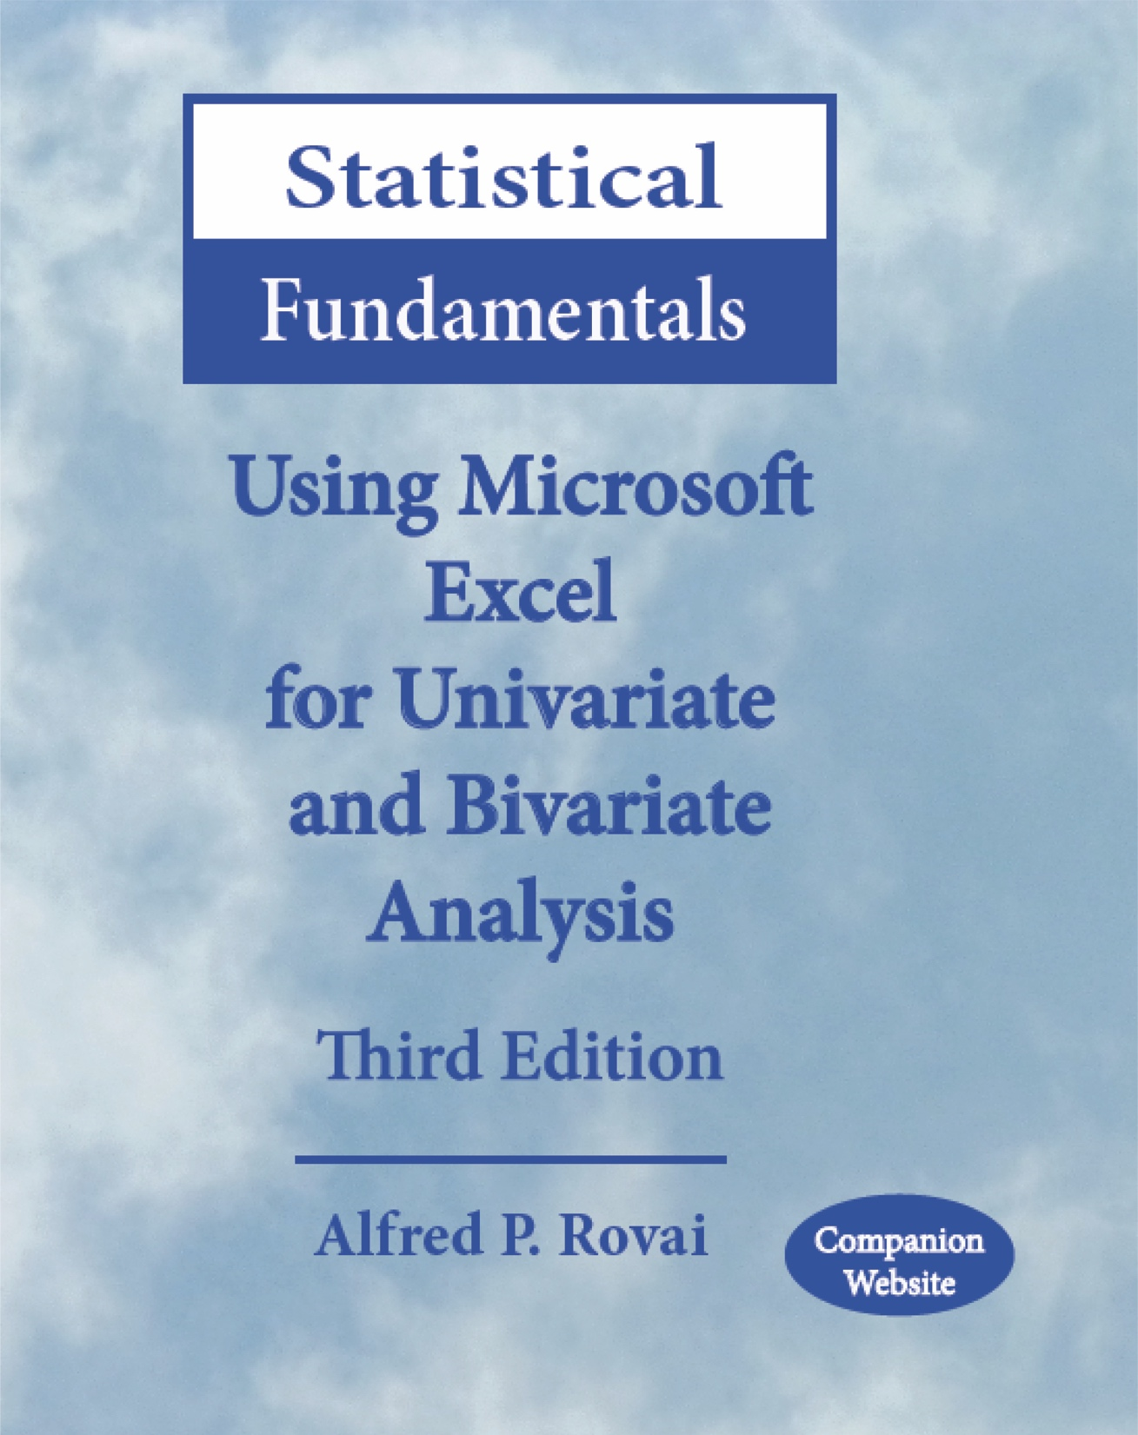
Statistical Fundamentals: Using Microsoft Excel for Univariate and Bivariate Analysis Alfred P. Rovai
Descriptive Statistics – Measures of Central Tendency
PowerPoint Prepared by Alfred P. Rovai
Microsoft® Excel® Screen Prints Courtesy of Microsoft Corporation.

Slide 2
Descriptive Statistics
Statistics
Summary measures calculated for a sample dataset.
Parameters
Summary measures calculated for a population dataset.
Used to describe variables
Measures of central tendency, e.g., mean, median, mode
Measures of dispersion, e.g., standard deviation, variance, range
Measures of relative position, e.g., percentile, quartile
Graphs and charts, e.g., scatterplot, column chart, histogram

Slide 3
Measures of Central Tendency Designed to give information concerning the typical score of a large number of scores.
Researchers typically report the best measures of central tendency and dispersion for each variable. The best measure to report varies based on the shape of a variable’s distribution and scale of measurement.
Interval/ratio data – mean, median, and mode can be calculated and reported, as appropriate.
Ordinal data - median can and should be reported; use of the mean is wrong.
Nominal data - mode can and should be reported; use of either mean or median is wrong.
 | Measures of Central Tendency
Nominal data | Mode
Ordinal data | Median, Mode
Interval data | Mean, Median, Mode
Ratio data | Mean, Median, Mode

Slide 4
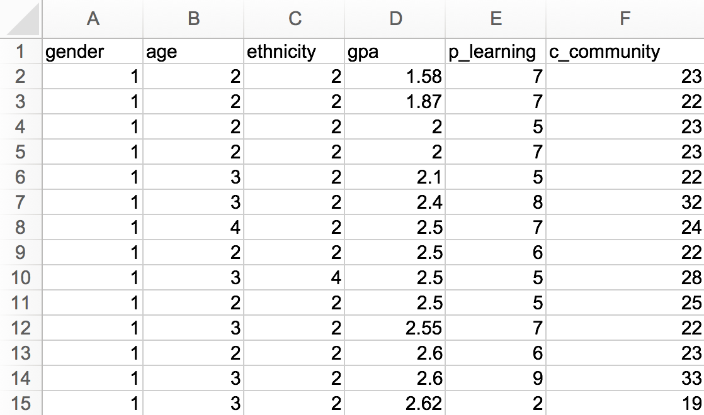
Calculating Measures of Central Tendency
Open the dataset Motivation.xlsx.
Click the worksheet Descriptive Statistics tab (at the bottom of the worksheet).
File available at http://www.watertreepress.com/stats
TASK
Calculate the count, mean, median, and mode of the classroom community (c_community) variable.

Slide 5
Count (Sample Size; N or n)
The count (N, n) is a statistic that reflects the number of cases selected in the dataset. It is often used to represent sample (N) or sub-sample (n) size. It is an important statistic in any research study. The mathematical consist of counting the number of cases represented by the data.
Excel functions:
COUNT(value1,value2,...). Counts the numbers in the range of values, e.g., the formula =COUNT(A1:A30) counts the number of values in cells A1 through A30. The result will be 30 in this example.
COUNTA(value1,value2,...). Counts the cells with non-empty values in the range of values. This functions counts cells with text as well as cells with numbers.

Slide 6
Example of Count
N = 9

Slide 7
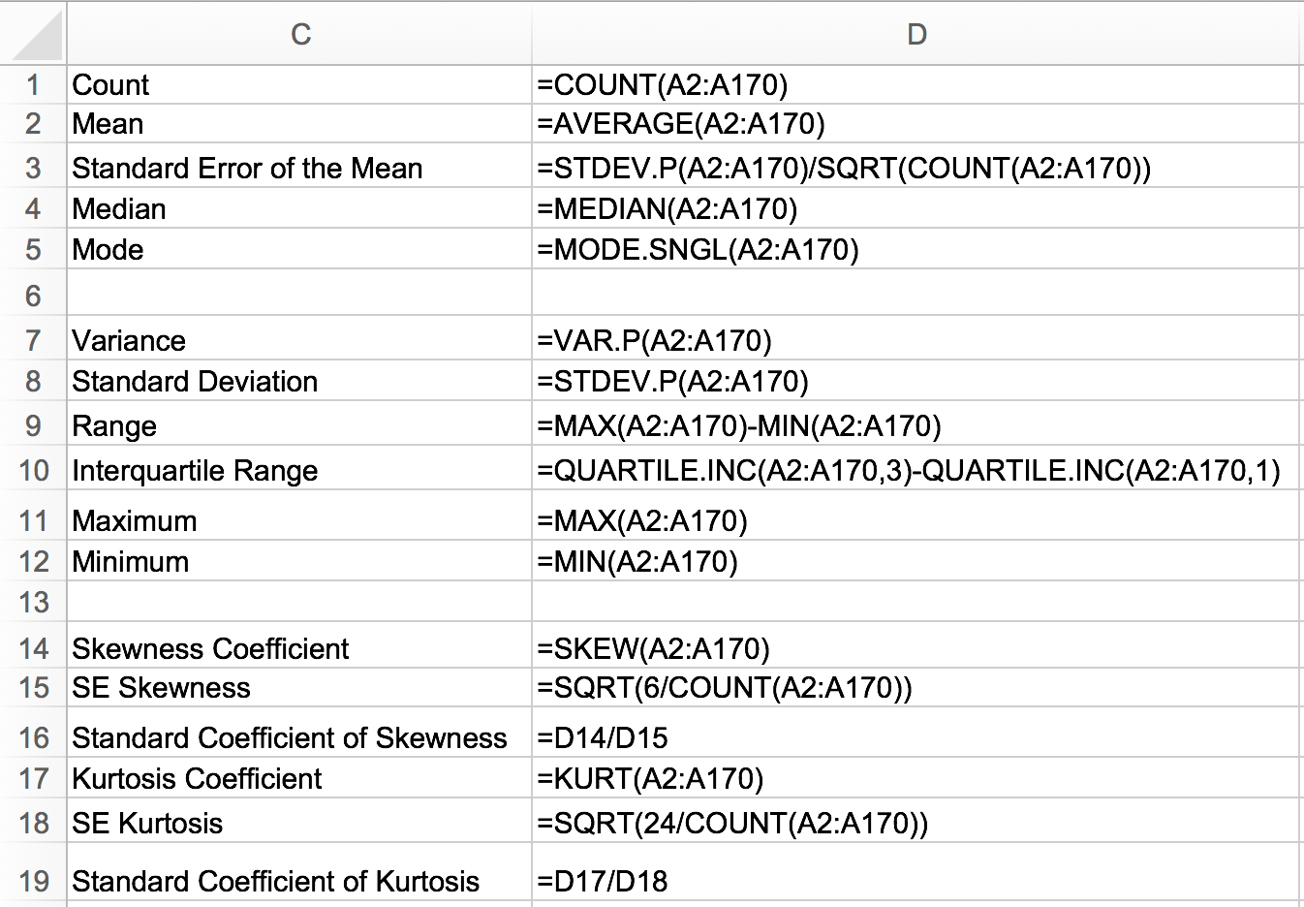
TASK
Enter the following formula in cell D1 to calculate the sample size used to measure c_community:
=COUNT(A2:A170)

Slide 8
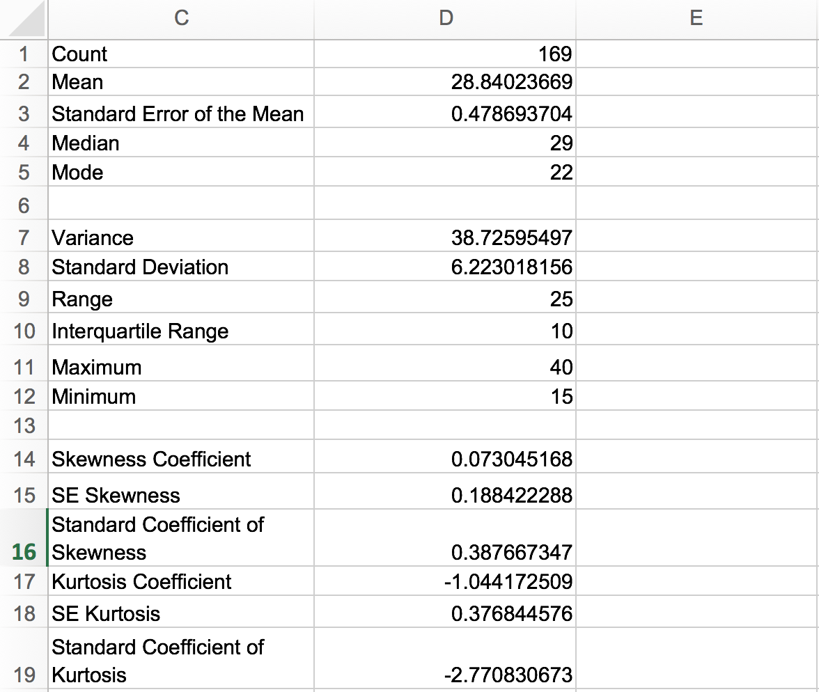
Excel displays the count as 169. This sample statistic is typically reported as N = 169 in the results section of a research paper, as appropriate. This statistic means that there are 169 cases in the measured sample.

Slide 9
Mean (Arithmetic Average; M ,µ)
Determines the sample mean or estimates an unknown population mean.
Sample mean is denoted by M or x-bar.
Population mean is denoted by the Greek letter μ (mu)
Used with interval and ratio scale variables.
Best measure to describe normal unimodal distributions. Unlike the median and the mode, it is not appropriate to use the mean only to describe a highly skewed distribution.
Always located toward the skewed (tail) end of skewed distributions in relation to the median and mode.
Formulas
Excel function:
AVERAGE(number1,number2,...). Returns the arithmetic mean, where numbers represent the range of numbers.

Slide 10
Example of Mean
The first column represents the raw score and the second column represent the raw score minus the mean (i.e., the deviation from the mean).
Mean = 6.33
Sum of deviations from the mean = 0

Slide 11
TASK
Enter the following formula in cell D2 to calculate the mean of variable c_community:
=AVERAGE(A2:A170)

Slide 12
Excel displays the mean as 28.84023669. This sample statistic is typically reported as M = 28.84 in the results section of a research paper, as appropriate. This statistic means that the arithmetic average of the sample is 28.84.

Slide 13
Median (Mdn)
The median is the score that divides the distribution into two equal halves (it represents the 50th percentile).
It is the midpoint of the distribution when the distribution has an odd number of scores.
It is the number halfway between the two middle scores when the distribution has an even number of scores.
Not sensitive to outliers.
Used with the ordinal scale or when the distribution is skewed
If the distribution is normally distributed (i.e, symmetrical and unimodal), the mode, median, and mean coincide.
Excel function:
MEDIAN(number1,number2,...). Returns the median of a range of numbers.

Slide 14
Example of Median
Median = 7
The median is the mid value of ranked data when there are an odd number of cases

Slide 15
TASK
Enter the following formula in cell D4 to calculate the median of variable c_community:
=MEDIAN(A2:A170)

Slide 16
Excel displays the median as 29. This statistic means 29 is halfway into the dataset when the data are rank-ordered.

Slide 17
Mode (Mo)
Most frequently occurring score
A distribution is called unimodal if there is only one major peak in the distribution of scores when displayed as a histogram
If the distribution is normally distributed (i.e, symmetrical and unimodal), the mode, median, and mean coincide
The mode is useful in describing nominal variables and in describing a bimodal or multimodal distribution (use of the mean or median only can be misleading)
Major mode = most common value, largest peak
Minor mode(s) = smaller peak(s)
Unimodal (i.e., having one major peak or mode)
Bimodal (i.e., having two major peaks or modes)
Multimodal (i.e., having two or more major peaks or modes)
Rectangular (i.e., having no peaks or modes)
Excel function:
MODE.SNGL(number1,number2,...). Returns the most frequently occurring value of the range of data

Slide 18
Example of Mode
Major mode: 7
Minor mode: 5

Slide 19
TASK
Enter the following formula in cell D5 to calculate the major mode of variable c_community:
=MODE.SNGL(A2:A170)

Slide 20
Excel displays the mode as 22. This means that 22 is the most frequently occurring value in the dataset.

Slide 21
Descriptive Statistics – Measures of Central Tendency
End of Presentation

